Slide 1




Understanding Crisis Response Measures
Collective sense making
Making A Referral to MAST (Multi Agency Safeguarding Team
Louise Fletcher Designated Nurse for Safeguarding Children, Children Looked After and Care Leavers

Slide 2
Overview of MAST
Latest Statistics
MAST Team Structure, Roles and Responsibilities
Information Sharing
How to make a referral

Slide 3
Overview of MAST- Multi-Agency Safeguarding Team
MAST covers the borough of Calderdale and is the first contact point for all new contacts where there are safeguarding concerns for children and young people. MAST is based at Princess Buildings and comprises of professionals from Children's Social Care, Health, Police and Education.
If a child or young person is known to Children's Social Care and there is a safeguarding concern you should contact their Named Social Worker.
MAST also offer’s an advice and information line.
Strategy Meetings are held where there is reason to believe a child has suffered or is at risk of Significant harm (under Section 47)

Slide 4
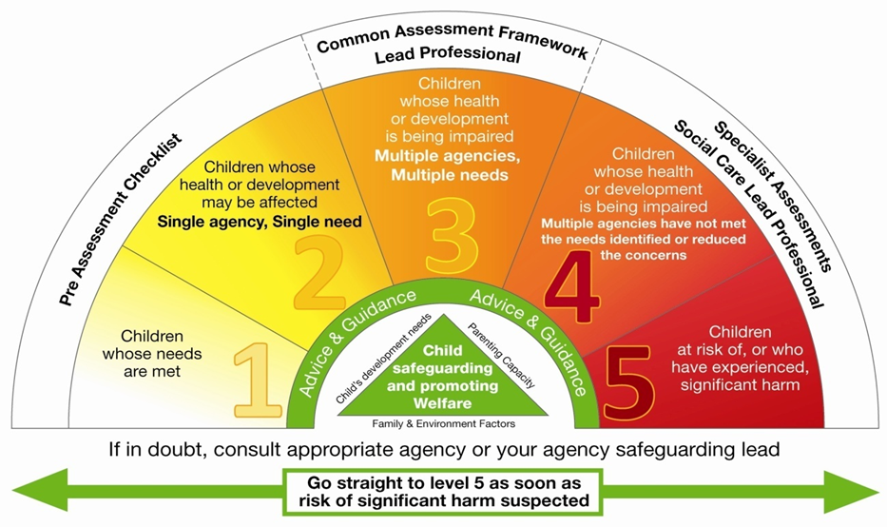

Slide 5
Statistics
Data from 3rd February 2021, evidenced MAST received 4458 referrals over a 6-month period prior to this date.
2212 lead to an assessment
On average MAST receives approximately 200 referrals a week.
Data indicates that approximately 23-26% of those referrals are passed on to the CAT (Children's Assessment Team) for a single assessment to be conducted.
There is a high filtering rate whereby referrals which don't meet the threshold are either closed or referred onto appropriate services i.e. Early Intervention, Health Visitor etc

Slide 6
MAST Team Composition
Team Manager
Practice Managers x 4
Referral and Information co-ordinators
Police
Health
6 Screening Social Workers
Early Intervention Single Assessment team
Education Representative via phone

Slide 7
MAST Roles and Responsibilities
Business Support
They are the first point of contact for the majority of referrals made to children services.
It is essential ACCURATE information is gathered and recorded, as this will inform any further action .
Screening social workers
The screening social work role is to review case files, gather information from referrers and other agencies, complete chronologies and analysis of the information to inform the next action to be taken.
MAST Manager and Practice Manager
Are the decision makers on all contacts and referrals and give the first management oversight on new casework. They undertake all Strategy Discussions and make appropriate records within timescales. The team Manager has management responsibility for providing management direction and supervision for all social workers within MAST.

Slide 8
Police
The role of the police within MAST is to contribute to the multi – agency discussions by providing the specialist police perspective and intelligence.
Health
The role of the health practitioner within MAST is to contribute to the multi-agency discussions by providing an analysis of the information held on the relevant health record and providing their specialist health knowledge and expertise to inform decision making.
Early Help Pathway
Collect and share information on behalf of the Early Intervention Single Assessment team in respect to the daily MAST referral meeting attended by Police, Health and CSC.
Education – via phone

Slide 9

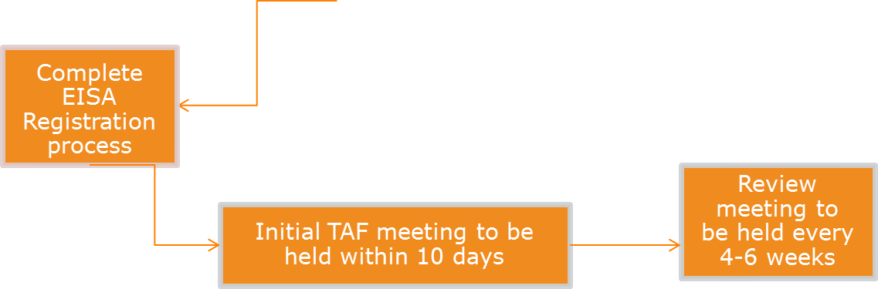

Referral to MAST
01422 393336 for initial consultation
Decision taken within 24 hours of the referral (Contact)
No Further Action
Recommend /Refer to Early Help
Strategy Discussion/Meeting (Schools can attend)
EPO / PPO
For allocation and social worker assessment
Single Assessment (45 working days

Slide 10
Escalation process within MAST
Disagreements between the referrer and the MAST decision maker are not common however if they cannot be resolved they should be escalated to:
First tier – Practice Manager
Second tier – Team Manager
Third tier – Service Manager

Slide 11
Working Together Dec 2020
Working Together Update December 2020. The Department for Education published a new edition of the statutory guidance “ Working together to safeguard children: a guide to inter-agency working to safeguard and promote the welfare of children”. Sets out a child centred approach
This is fundamental to safeguarding and promoting the welfare of every child. A child centred approach means keeping the child in focus when making decisions about their lives and working in partnership with them and their families.

Slide 12
Information Sharing
Consent causes some uncertainty-
All practitioners should aim to gain consent to share information, but should be mindful of situations where to do so would place a child at increased risk of harm.
Information may be shared without consent if a practitioner has reason to believe that there is good reason to do so, and that the sharing of information will enhance the safeguarding of a child in a timely manner.
When decisions are made to share or withhold information, practitioners should record who they have shared the information and why.
Remember the 7 Golden Rules for Information Sharing.
Notes:
Remember that the General Data Protection Regulation (GDPR) is not a barrier to sharing information but provides a framework to ensure that personal information about living persons is shared appropriately.
2. Be open and honest with the person (and/or their family where appropriate) from the outset about why, what, how and with whom information will, or could be, shared, and seek their agreement, unless it is unsafe or inappropriate to do so.
3. Seek advice if you are in any doubt, without disclosing the identity of the person where possible.
4. Share with consent where appropriate and, where possible, respect the wishes of those who do not consent to share confidential information. You may still share information without consent if, in your judgement, that lack of consent can be overridden in the public interest. You will need to base your judgement on the facts of the case.
5. Consider safety and wellbeing: base your information-sharing decisions on considerations of the safety and wellbeing of the person and others who may be affected by their actions.
6. Necessary, proportionate, relevant, accurate, timely and secure: ensure that the information you share is necessary for the purpose for which you are sharing it, is shared only with those people who need to have it, is accurate and up to date, is shared in a timely fashion, and is shared securely.
7. Keep a record of your decision and the reasons for it – whether it is to share information or not. If you decide to share, then record what you have shared, with whom and for what purpose.

Slide 13
How to make a referral
Be clear about why you are referring today?
Be available for a phone call back
Prior to the call make sure you have all the correct information which is available to you ie full name/alias, dob, address
Provide an overview- what do you know about the family that would be useful for us to know, when did you get this information?
Only include key information
A good referral is not always a lengthy one
Who, what, where, when
What has the child explicitly said/ the child’s words
If this is about an injury – is there a visible injury? Explanation?
Is this current/historical or both?
Document presentation of parent/child e.g. hostility, relationship between parent and child, presentation, cleanliness, general appearance.
Say whether parents have been spoken to and if not why not

Slide 14
How to make a referral continued
Make sure your initial phone contact with MAST is clearly documented in the health record.
Following contact with MAST please complete a MAST referral within 24hrs.
If you have concerns for the immediate safety of a baby, child or young person: AT THE POINT OF REFERRAL, AN INTERIM SAFETY PLAN WILL BE AGREED BETWEEN THE REFERRER AND CHILDRENS SOCIAL CARE UNTIL A STRATGEY DISCUSSION HAS TAKEN PLACE

Slide 16
Contacts and Referrals
Contact 01422 393336 – for all advice in the first instance.
MAST accept all written referrals on the referral template which can be found on www.calderdale-scb.org.uk/reporting-a-concern
Send to MASTadmin@calderdale.gcsx.gov.uk
This email address can also be used to request a call back if you are struggling to get through.
Contact the Safeguarding GP in you practice for support if required or a member of Calderdale CCG Safeguarding Team.

Slide 17
Calderdale CCG Safeguarding Team
Louise Fletcher
Designated Nurse Safeguarding Children,
Children Looked After & Care Leavers.
Contact: 07904653331 louise.fletcher6@nhs.net
Luke Turnbull
Designated Nurse Safeguarding Adults
Contact: 07775903676
luke.turnbull@nhs.net
Gwen Clyde-Evans
Deputy Designated Professional Children/
Adults
Contact: 07535003212
gwen.clyde-evans@nhs.net
Dr Paul Glover
Named GP Safeguarding Children
paul.glover1@nhs.net
Dr Susi Harris
Named GP Safeguarding Adults
susi.harris@nhs.net

