Slide 1
Calderdale Protected Learning Time Seminar
Personal resilience
Will Clement

Slide 2
Aim
2
To provide tools and techniques and a safe space for you to reflect on yourself.
An opportunity to choose techniques that you want to deploy to move ‘beyond resilience’
This session will provide inconvenient truths and uncomfortable thoughts and a different view of resilience

Slide 3
Beyond resilience
In essence, "beyond resilience" implies a shift from simply weathering the storms of life to actively growing, evolving, and finding meaning and purpose.
It's about reflecting upon personal challenges as opportunities for growth and transformation, ultimately leading to a higher level of well-being.

Slide 4
Compassion
Question – what is the longest relationship you have ever had?
Now consider – when was the last time you checked-in with yourself?
If not, why not?
Some reasons I find through coaching are:
‘it feels selfish’
‘if I have an ounce of energy left I feel like I haven’t done enough’ and,
‘It is always about other people’
4

Slide 5
Compassion fatigue
It’s real, it is happening every day and yet we still fail to deal with it.
In essence, healthcare professionals aim to care for the patient and their community. From Practice Managers, Clinicians, and Receptionists to Analysts, compassion fatigue can affect everyone
The issue comes when we don’t recognise the slow walk towards burnout, or we do but feel selfish that we have energy left
Without recognising compassion fatigue, we run the risk of severe self-explotation
5

Slide 6
Symptoms of burnout
Sick and tired
You fear everything will fall apart if you stop
You have noticed you are getting ill where you once healthy
Work is not pleasurable
Burning out
You put more effort in an achieve less
Your self-confidence in waning
You want to get off the treadmill – there is too much to do
Holidays are taking up with thinking about the stack of work when you get back
Burned out
You feel nothing you do makes a difference
You are exhausted from the moment you wake up
The thought of you being seriously ill makes you think at least you’ll get some rest
6

Slide 7
A view of you
Consider the three aspects below
What is a good version of you?
What is a better version of good?
What is the best version of you?
How many times do you use could’ve / would’ve / should’ve?
Assess where you are now
Inconvenient truth
Personal adversity is unplanned
7

Slide 8
Emotional intelligence – a definition
The ability to identify and control our emotions in any given scenario or environment
Emotional agility is the ability to view others, recognise their emotions and find a constructive way to deal with ourselves and adapt to their emotions
If we are emotionally agile and don’t recognise it, this can lead to compassion fatigue

Slide 9
Multiple intelligences Howard Gardner
Bodily-Kinesthetic
Naturalist
Spatial
Linguistic
Musical
Intra-Personal
Inter-personal
Logical/Mathematical
Emotional
Intelligence

Slide 10
Multiple intelligences Howard Gardner
Linguistic intelligence: the ability to use language effectively
Logical-mathematical intelligence: the ability to reason and solve problems
Spatial intelligence: the ability to perceive and manipulate visual information
Musical intelligence: the ability to create and appreciate music
Bodily-kinesthetic intelligence: the ability to control and coordinate body movements
Interpersonal intelligence: the ability to understand and interact with others
Intrapersonal intelligence: the ability to understand and regulate oneself
Naturalistic intelligence: the ability to recognize and classify natural phenomena
Existential intelligence: the ability to ponder deep questions about life (not confirmed by Gardner)

Slide 11
Intelligence in practice
Intra-personal – taking place in the mind
Interpersonal – relating to communications and relationships between people
What tactics could you utilise to aid you in taking thoughts from the mind into the open?

Slide 12
Emotional intelligence
Self-Awareness
Self Confidence
Accurate Self-Assessment
Emotional Self-Awareness
Social Awareness
Compassion
Responsiveness to Others
Organisational Awareness
Self-Management
Adaptability
Emotional Self-Control
Positive Outlook
Initiative
Relationship Management
Conflict Management
Inspirational Leadership
Influence
Teamwork

Slide 13
Personal exercise - Emotional intelligence
Self-Awareness
Self Confidence
Accurate Self-Assessment
Emotional Self-Awareness
Social Awareness
Compassion
Responsiveness to Others
Organisational Awareness
Self-Management
Adaptability
Emotional Self-Control
Positive Outlook
Initiative
Relationship Management
Conflict Management
Inspirational Leadership
Influence
Teamwork
Question – What is compassion? How does this relate to empathy?

Slide 14
Personal exercise - Emotional intelligence
Self-Awareness
Self Confidence
Accurate Self-Assessment
Emotional Self-Awareness
Social Awareness
Compassion
Responsiveness to Others
Organisational Awareness
Self-Management
Adaptability
Emotional Self-Control
Positive Outlook
Initiative
Relationship Management
Conflict Management
Inspirational Leadership
Influence
Teamwork
From the aspects you have chosen – what enables you to enhance the chosen element and, what barriers are there to enhancing it/them?

Slide 15
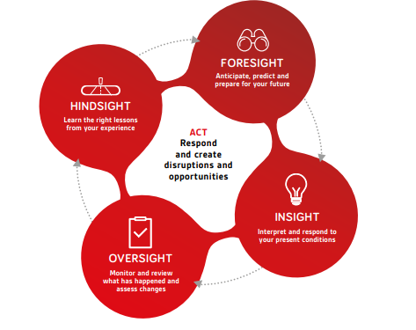
4-Sight Model From organisation to individual
Hindsight – Learning the right lessons from your experience
Foresight – Anticipate, predict and prepare for your future
Insight – Interpret and respond to your present conditions
Oversight – Monitor and review what is happening and assess changes
Adapted from David Denyer
15

Slide 16
4-Sight Model A view of individual resilience
Hindsight – Reflecting on when you felt resilient and performing. What is different
Foresight – Creating a vision of you in the future and a view to change habits for the better
Insight – Interpret and recognise your present conditions
Oversight – Monitor and review what is happening in order to assess changes
Adapted from David Denyer
16

Slide 17
Changing habits
17
Foresight – Anticipate, predict and prepare for your future
Focus – Do you have a plan?
Energy - When are you alert and considered?
Downtime – How do you relax – do you work?
Optimism – ‘I see the point and have a plan’

Slide 18
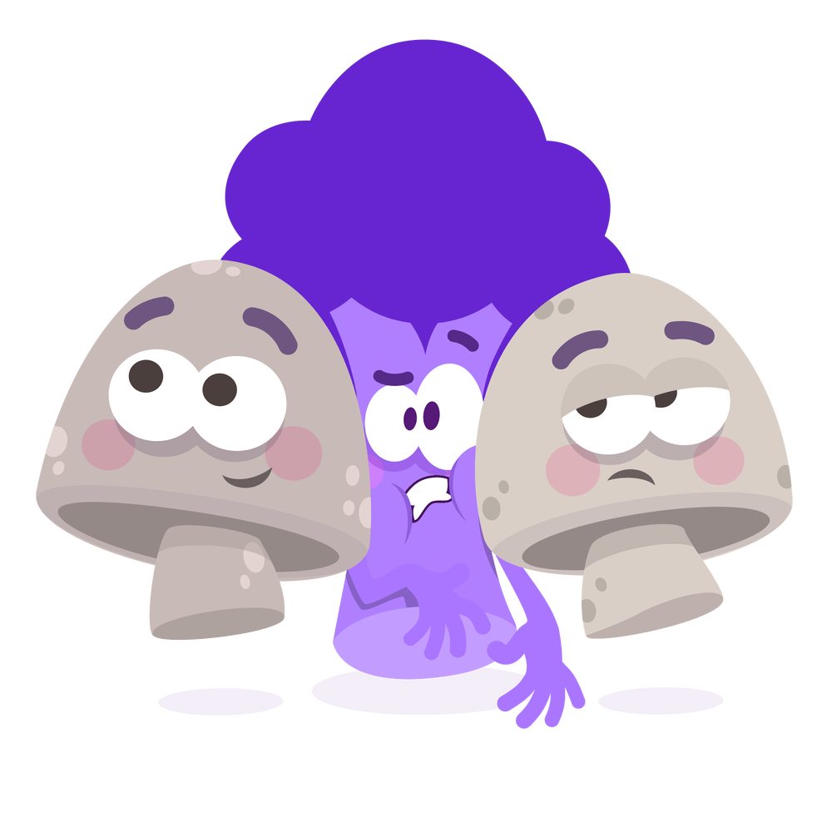
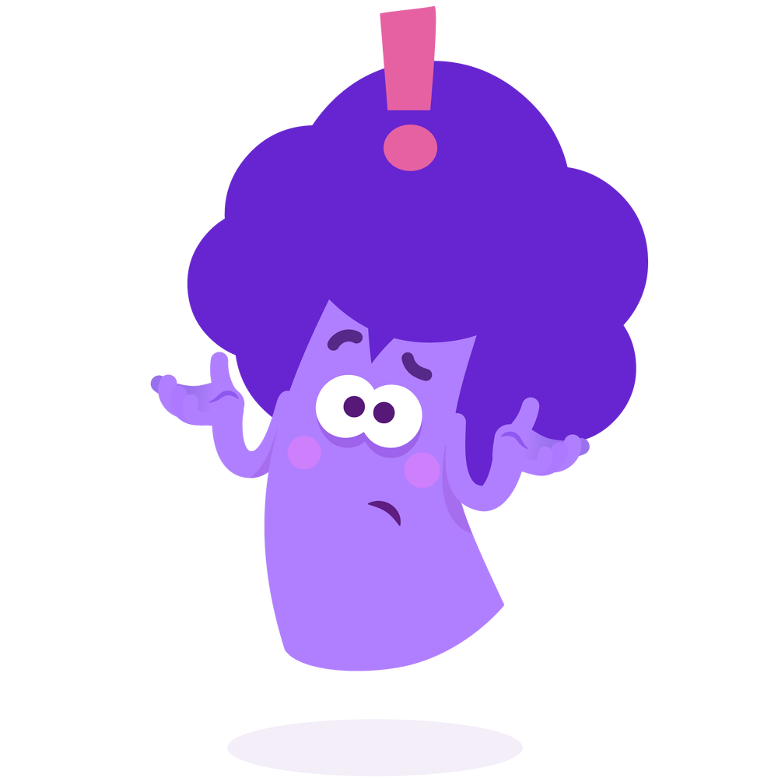
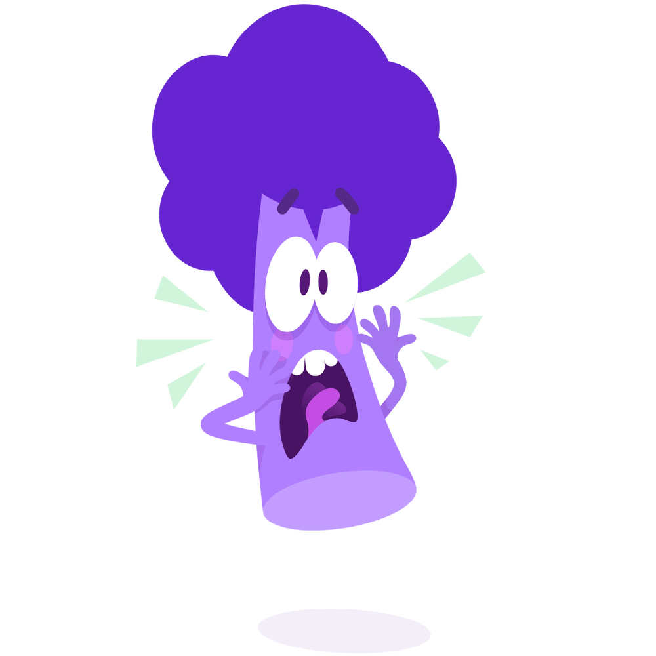
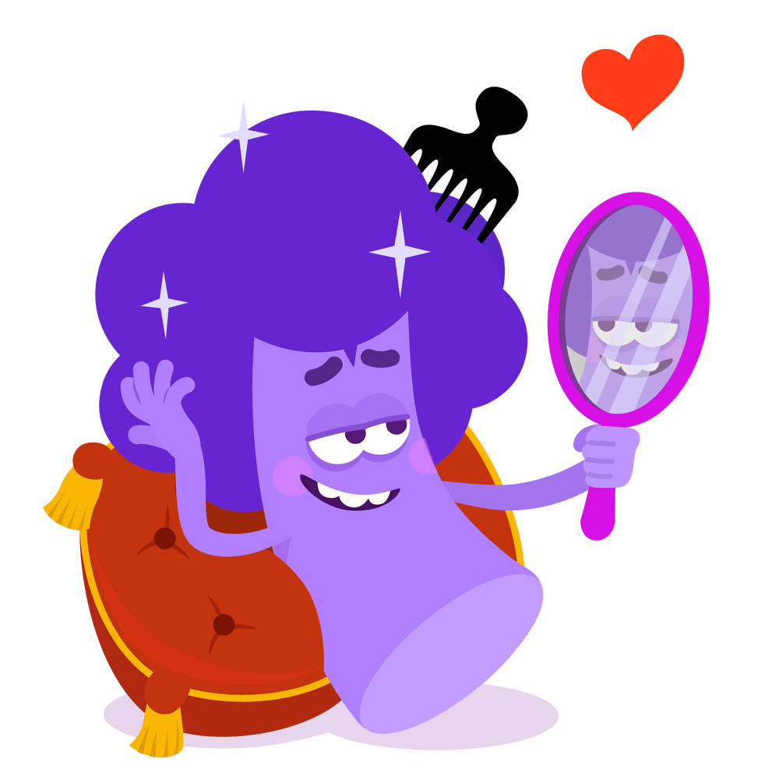
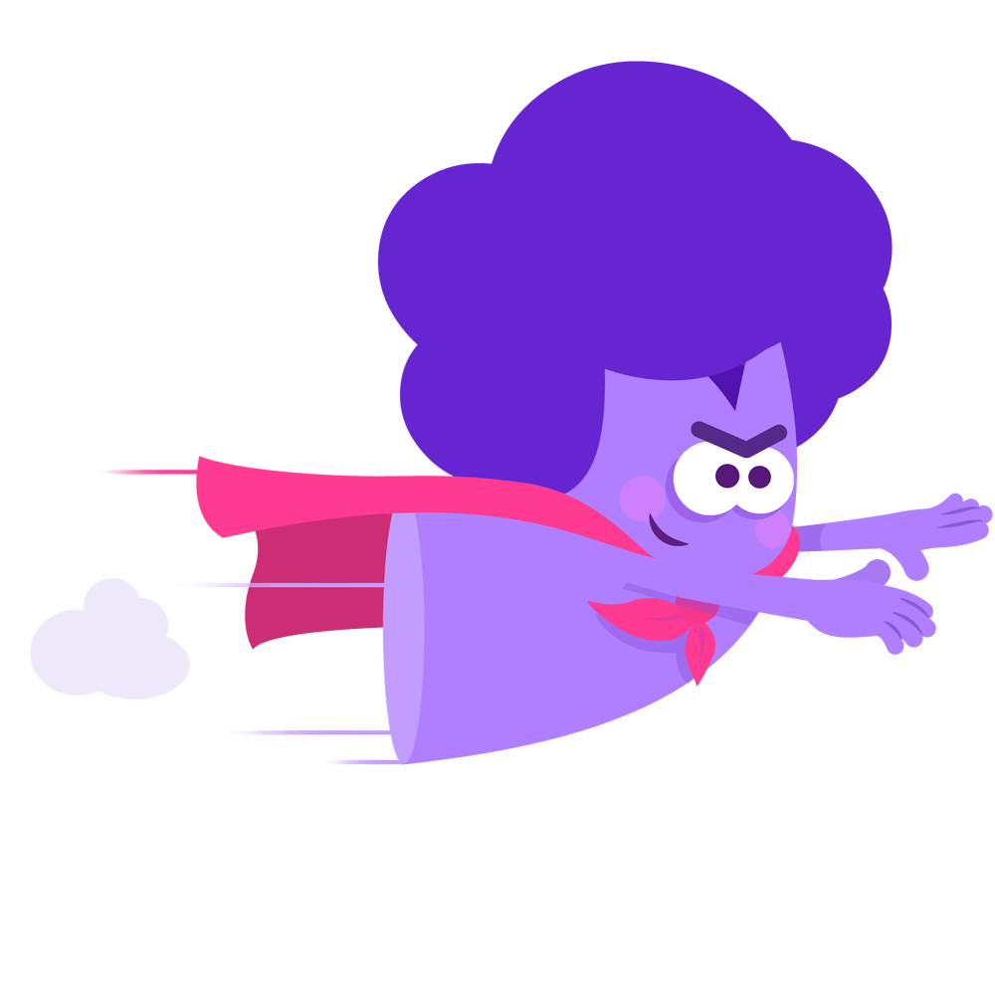
Reflection
How are you feeling – be ready to share a reflection on the course so far – what has been significant for you

Slide 19
Changing habits
19
You can’t plough a field by just thinking about it
Foresight – Anticipate, predict and prepare for your future
Focus
Energy
Downtime
Optimism
Optimism
Focus
10
0
Gap analysis to create actions
Downtime
Energy

Slide 20
The horizonal model
20
Step 1 View yourself and how you would want to be in 1 years-time
More time for you
Less tired
Healthier
More in touch with the right people for you
Step 2 Reflect on you now
Use the real truth about yourself
How do you match up to the future version?
Step 3 What are just 2 steps towards step one version of you?
What are real practical actions you can make
Start small, take one step
Create a new habit
Review

Slide 21
Changing habits
21
Insight – Interpret and respond to your present conditions
We need to confront our brutal truths if we are to truly restore
Value driven
Design your peer group
Inconvenient truth We are human
Adapted from Angela Armstrong – ‘The Resilience Club’

Slide 22
Value-driven
22
Insight – Interpret and respond to your present conditions
People
The welfare of others
Purpose
Direction and focus
Team
Flexible and social
Source: Elias Porter – Relationship theory
Process
Using valid information

Slide 23
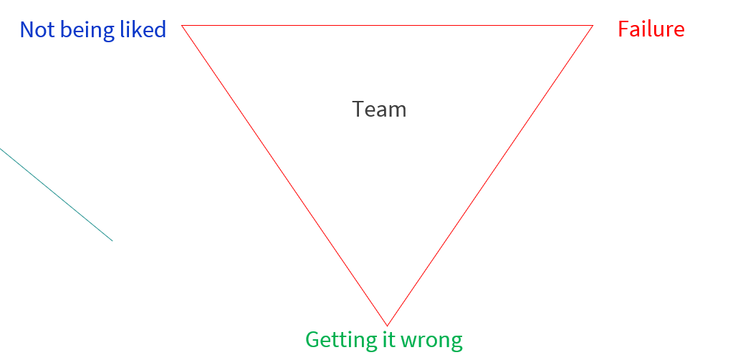
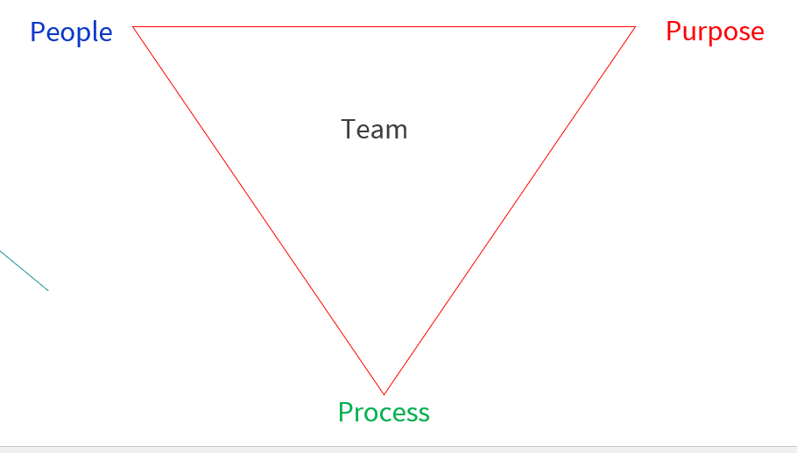
Values attacked
23
Insight – Interpret and respond to your present conditions
Isolation
Source: Elias Porter – Relationship theory

Slide 24
A view from above - oversight
24
The Drama Triangle
Rescuer
Shadow ‘Parent’ – seeks approval
Persecutor
Shadow ‘parent’
Seeks control
Inconvenient truth
You are not your emotions
You are not your thoughts
Victim
Shadow ‘child’
Seeks security

Slide 25
The empowerment dynamic
25
Creator
Creator – Directed by intention, focusses on outcomes, take a forward approach and embodies respons-ability
Coach – Uses self-compassion and encourages to produce positive next steps in place of ‘rescuing’ ego states
Challenger – Focussed on personal learning and growth. Constantly builds and negates blame and control
Challenger
Coach
Model by David Emerald

Slide 26
Changing habits
26
Oversight – Monitor and review what is happening and assess changes
Consider this as viewing not only your level of emotional intelligence but your emotional agility
How much self-awareness do you have?
What happens to you in common environments i.e. What happens to your behaviour - transactional analysis - Parent / Adult / Child?
What would you like to happen, i.e. Stay in control, manage emotions such as annoyance et cetera?

Slide 27
Changing habits
27
Design your peer group
Create the following:
‘A’ People – those who lighten your mood / are positive and supporting and inspire you
‘B’ People – Who you are comfortable around
‘C’ People – Those who lower your mood or do not contribute strongly to your relationship - a consideration is those you ‘have to be near’ is minimised
Through a re-design, you can ensure that your emotional account is topped up.

Slide 28
Evaluation
28

Slide 29
Keep in touch
29
w.clement@inpd.co.uk
X (formerly Twitter) Willclement5
LinkedIn – Will Clement

Slide 30
Reflections and Questions

