Slide 1
Introduction to Behavioural Science
Lisa Wheater
Nadia Sethi
The WY&H Cancer Alliance is part of the WY Integrated Care Board - www.canceralliance.wyhpartnership.co.uk
Twitter: @WYpartnership

Slide 2
WHAT IS BEHAVIOURAL SCIENCE?
The study of “human habits, actions and intentions”
It brings together thinking from psychology, economics and service redesign to help us to understand why people behave the way they do
Introduction to Behavioural Science

Slide 3
IMPORTANT TO NOTE
Our work never seeks to take choice away from people or force them into a particular decision.
We aim to INFLUENCE people to make choices that are most likely to benefit them and/ or wider society.
WHAT IS A ‘NUDGE’?
Something that influences a person to behave in a predictable way without reducing the choices available to them. Nudges are generally subtle, and the individual remains in control.

Slide 4
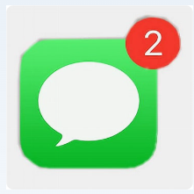
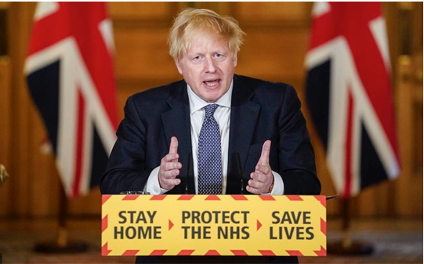
Nudges are everywhere

Slide 5
WHY ARE WE INTERESTED IN ‘NUDGING’ PEOPLES BEHAVIOURS?
We know that traditional approaches such as educating or informing people don’t always work
Our behaviour is more likely to be influenced by:
Changes to a context
The way that a choice is framed
Who is communicating a message
What other people do

Slide 6
The 3 Concepts
Thinking fast, thinking slow
Shortcuts and filters we all use to process information
Understanding barriers that stop people engaging

Slide 7
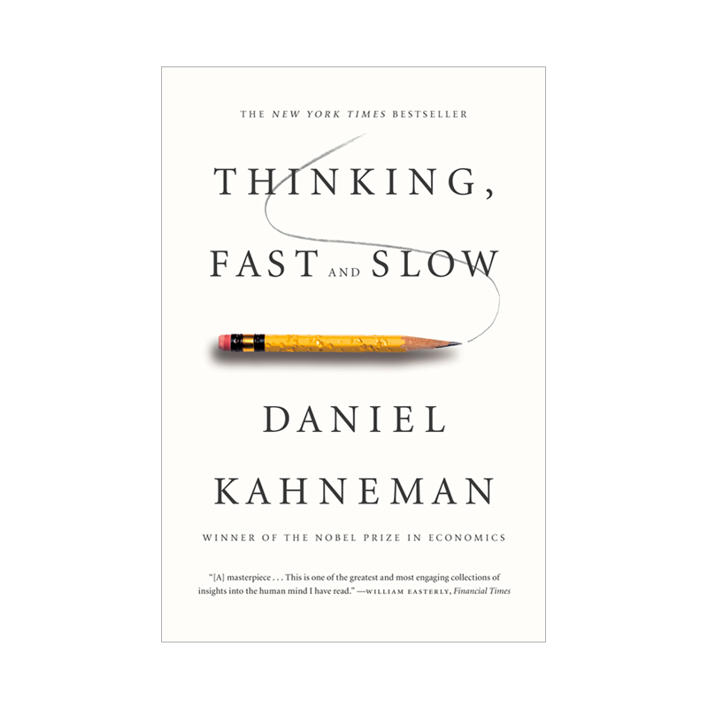
Concept 1 : Thinking Fast & Thinking Slow
This concept was explained by the Nobel Prize winning Psychologist & Economist Daniel Kahneman through his research and book: Thinking Fast & Slow.
Often when we design policies and services for people we assume that people will always use consideration and judgement when deciding what they want to do – this is known as ‘System 2 Thinking’ or THINKING SLOW
In Behavioural Science we consider if people could make quicker and more automatic decisions based on what is presented to them – this is known as ‘System 1 Thinking’ or THINKING FAST

Slide 8
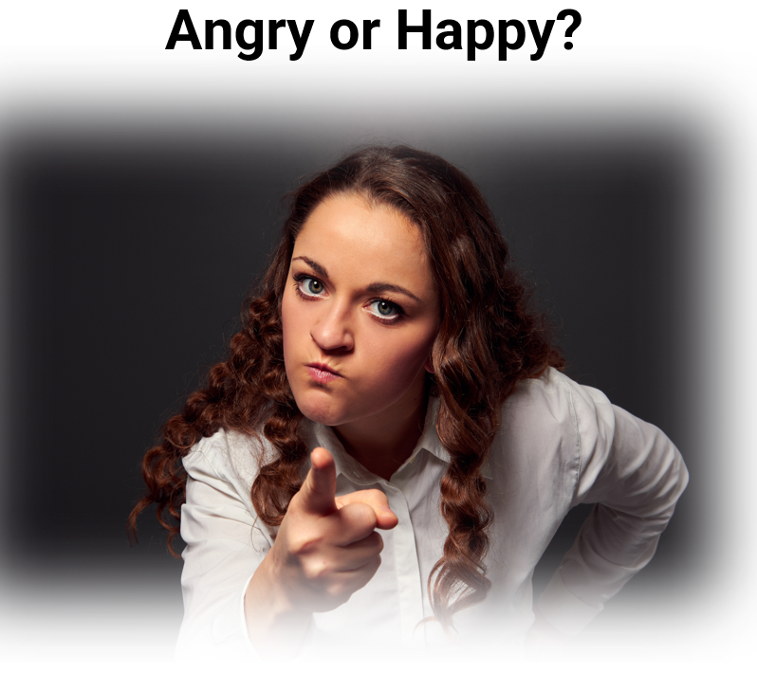
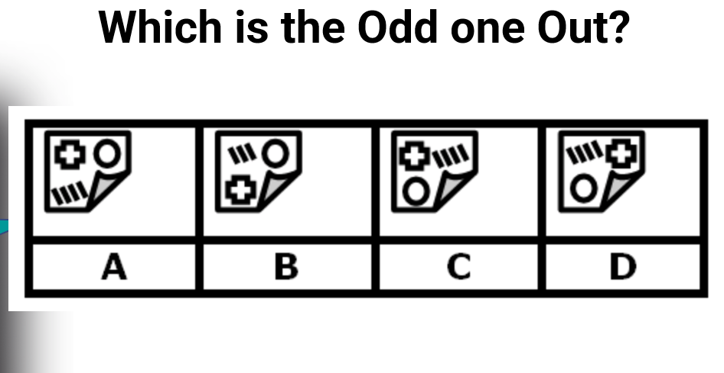
Thinking Fast & Thinking Slow

Slide 9
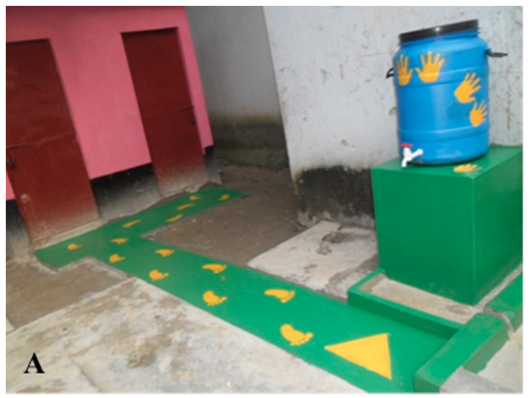
Case Study – Thinking Fast in Action
Bangladesh – Handwashing in Primary Schools
A study was undertaken with 2 rural Primary Schools in Bangladesh to increase handwashing after children visited the toilet (2016).
A set of inexpensive set of visual nudges to encourage handwashing with soap were developed. No additional education was done.
Handwashing increased from 4% to 68% the day after nudges were completed and 74% at both 2 weeks and 6 weeks post-intervention.

Slide 10
Concept 2 : Mental Shortcuts
Common shortcuts our brains use to process the huge amount of information we receive everyday

Slide 11
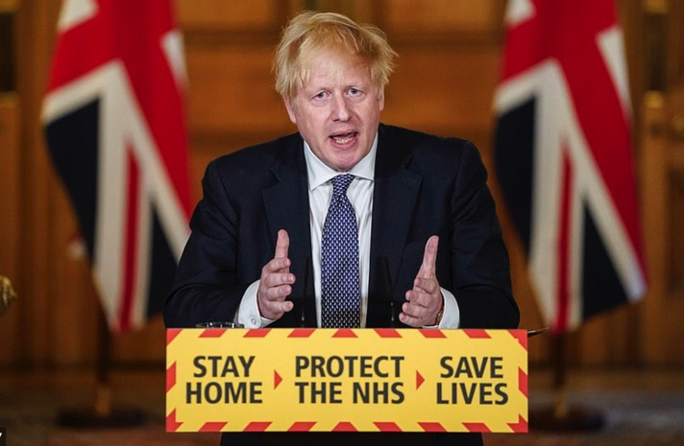
MESSENGER
We are strongly influenced by who communicates information

Slide 12
SOCIAL NORMS
We are strongly influenced by what others do

Slide 13
LOSS AVERSION & ANTICIPATED REGRET
People will work harder to keep something than they will to acquire it in the first place. We also instinctively fear missing out

Slide 14
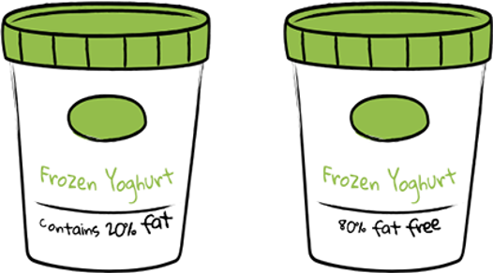
FRAMING
How something is presented, positively or negatively, has a huge impact on how we process exactly the same information

Slide 15
DEFAULT
We ‘go with the flow’ of pre-set options​

Slide 16
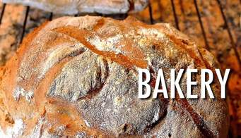
PRIMING
Our acts are often influenced by subconscious cues – smells,
sounds, associations

Slide 17
Concept 3 : Barriers
Understanding the factors that get in the way of people making a choice and/or behaving in ways that benefit themselves or wider society

Slide 18
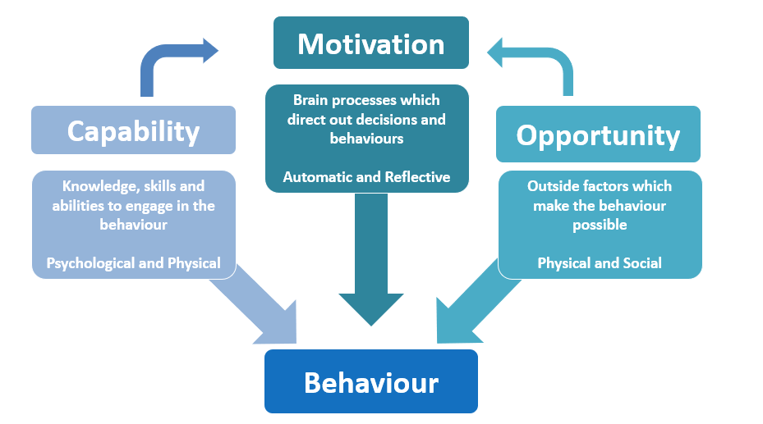
COM-B
We know that three key factors determine and limit people’s behaviour

Slide 19
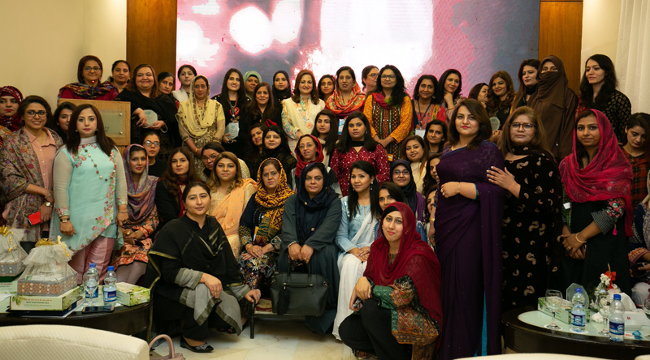
Applying COM-B in practice
Influencing women from South Asian populations to come forward for screening

Slide 20
Nudges in Practice

Slide 21
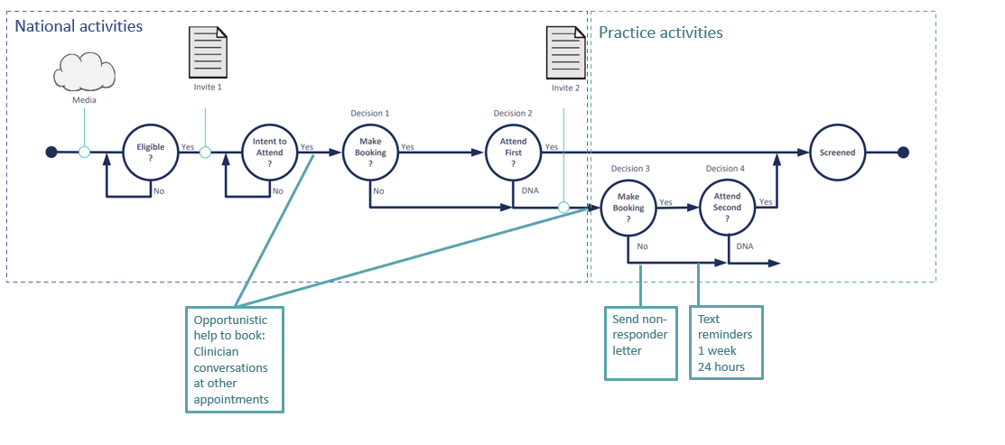
The Nudges
The approach centres on identifying the points on the screening pathway at which individuals can make a behaviour choice
Notes:
Simple pathway helps us identify which decision points have greatest potential for behaviour change
This is where we implement our nudges
Convo cards opportunistic after 1st national letter, proactive after 2nd
If still DNA after 2nd pull NR list and send letter and text reminders
If still nothing – look for opportunistic times for convo

Slide 22
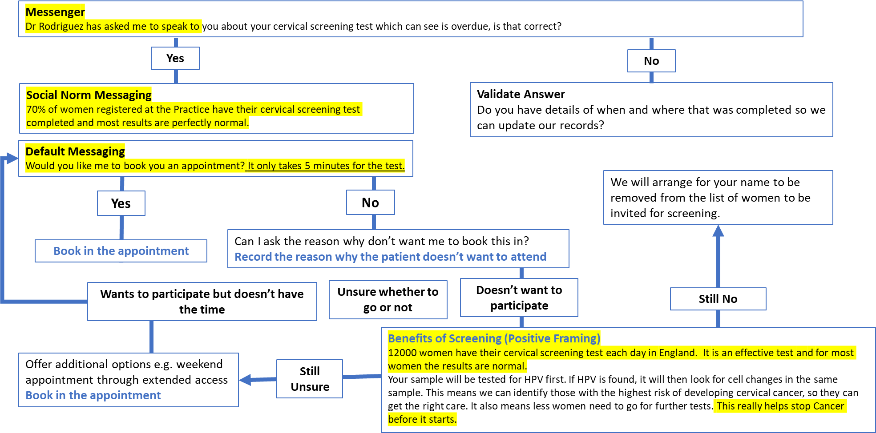
Proactive Help to Book Semi Scripted Conversation

Slide 23
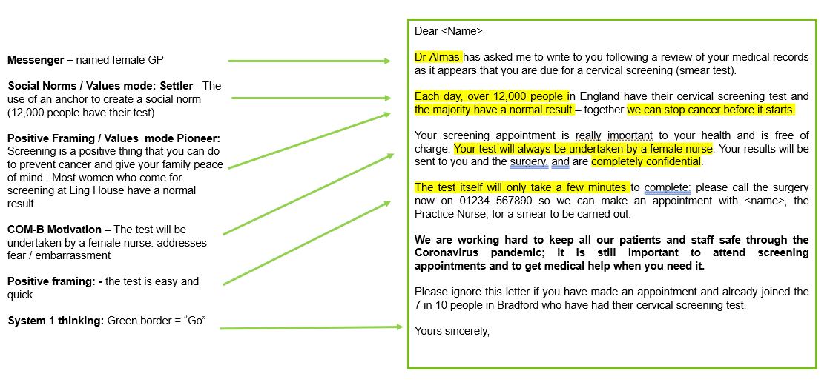
Non-responder letter - generic

Slide 24
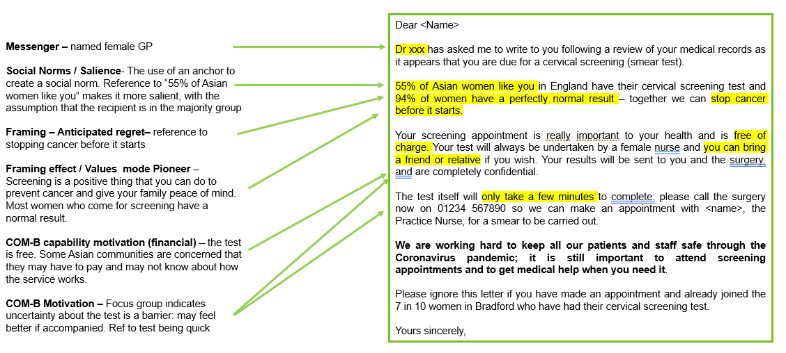
Non-responder letter – Asian women
Notes:
Differences based on COM-B observations
Bengali and Urdu translations

Slide 25
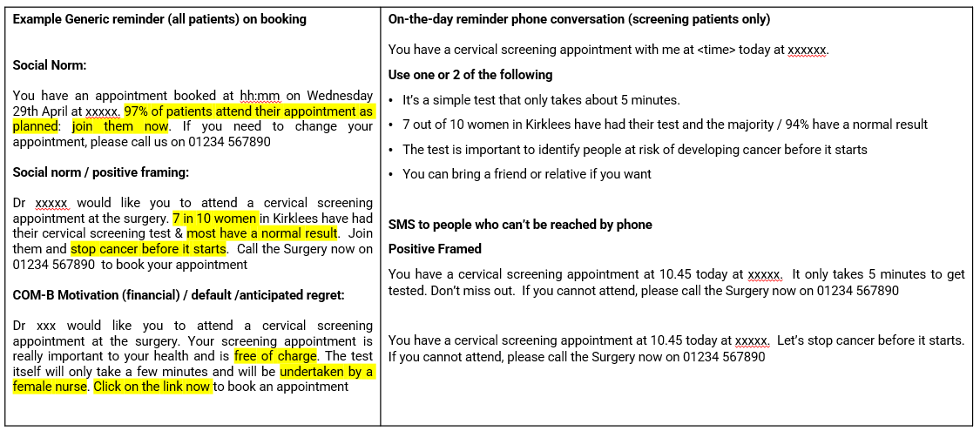
SMS Appointment Reminders
Suggested wording for nudges below. Practice to agree which they wish to use.

