Slide 1
CVD in Calderdale
Emily Turner
West Yorkshire Clinical Lead for CVD Prevention
Emily.turner1@nhs.net

Slide 2
Objectives
Understand the local CVD landscape in Calderdale
Updates on changes to CVD targets and management in primary care
Practical tips on prioritisation and meeting QOF indicators for hypertension, lipids and AF
Discuss clinical leadership in your PCNs and practices
Exploration of learning needs

Slide 3
Why is CVD Prevention important?
Raised BP and high cholesterol are often asymptomatic
These are leading causes of heart attack and stroke (and CKD!)
Treatment to lower BP and cholesterol is highly effective at preventing these life-changing events
Preventing heart attacks and strokes at scale could save thousands of lives and millions of £
CVD currently accounts for 25% of deaths under the age of 75
CVD contributes to major health inequalities
Tackling CVD prevention is probably the biggest thing we can do to ensure the NHS is sustainable!

Slide 5
CVD mortality in Calderdale
Deaths from circulatory disease for people under 75yo
21% above England average (April 21), in worst performing 25% of CCGs in England
Deaths from coronary heart disease (all ages)
16% above England average (2021), in worst performing 30% of CCGs in England
Stroke rates under 75 years
45% above than England average (2020), in worst performing 15% of CCGs in England
No change since 2011

Slide 6
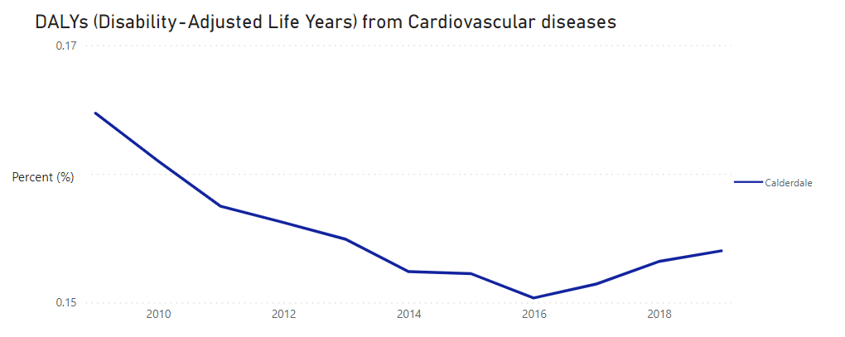

Slide 7
Recent changes to targets for risk factors
1) National operational planning guidance targets
77% of people with hypertension treated to age appropriate BP
60% of people with QRISK >20% on lipid lowering therapy
2) Changes to QOF
Addition of 2 new cholesterol indicators
2 AF indicators moved from IIF to QOF
Notes:
CVD QOF makes up a 3rd of QOF points >200

Slide 8
Hypertension

Slide 9
Notes:
3000 patients

Slide 11
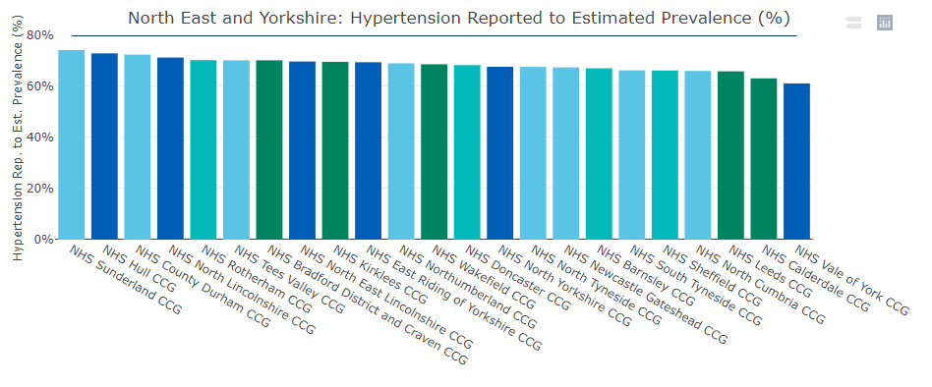
Performance to estimated hypertension prevalence
2nd worst performing CCG in North East and Yorkshire (higher prevalence is better)
Central Halifax and Upper Calder Valley both in lowest 10% for prevalence in West Yorkshire
Notes:
35/47 pharmacies signed up to deliver BP check service but very few are doing big numbers of checks and even less are doing ABPM

Slide 12
Community pharmacy BP checks

Slide 13
Why is hypertension THE priority?
Leading modifiable risk factor for CVD
>23,000 are undiagnosed and therefore untreated
Leading cause of CKD
Significant contributor to HF and AF
Contributing factor to ~100 deaths a year in Calderdale
Estimated >46,000 adults in Calderdale have HTN
Biggest contributor to adult disabilities (through stroke)
Costs the NHS in Calderdale ~£750,000 a year
It is usually ASYMPTOMATIC
Notes:
So why is hypertension important?
Well, it is the leading modifiable risk factor for CVD and an estimated 15.5 million adults have it.
Of those that are diagnosed, 37% have uncontrolled hypertension and an estimated 7million are undiagnosed.
It is the leading cause for CKD and a significant contributor to heart failure and AF. Overall it contributes to an estimated 20,800 deaths in England every year. Alongside deaths, hypertension is the most common risk factor for stroke which is one of the leading the causes of adult disabilities.
Hypertension is estimated to cost the National Health Service (NHS) in England over £2 billion annually. This includes costs associated with treating high blood pressure, as well as the costs of related complications such as heart disease, stroke, and kidney disease. Additionally, there may be indirect costs such as lost productivity and decreased quality of life for individuals and their families.
The major issue with hypertension is that it is usually asymptomatic and therefore most people have no idea they have it.

Slide 14
The impact of hypertension on patients
Stroke
Heart attacks
Chronic kidney disease
Dementia
Heart failure
Aneurysms
Loss of eye sight
Sexual dysfunction
Premature death
Disability
Poor quality of life
Impact on family from care needs
Financial impact through inability to work

Slide 15
69 QOF points available for BP management (11% of QOF)!

Slide 16
Blood Pressure and Risk
For every increase of 20/10mmHg over 120/80mmHg there is a doubling of mortality from stroke and IHD (relative risk)
10mmHg systolic BP increase
17-24% increase risk CHD
30-62% increase risk stroke
The baseline is individual
Chobanian et al. 2003 doi: 10.1161/01.HYP.0000107251.49515.c2.
Notes:
Hypertension is directly related to stroke and heart disease risk.
Even small increases in systolic BP can result in big increases in stroke and heart attack risk. For every 20mmgHg increase in systolic BP it is recognised that there is a doubling in relative risk from an individuals baseline. Other studies quote varying figures depending on the populations studied and the focus but overall the message is clear that small increases in BP can have big impacts on the risk of major cardiovascular outcomes.
If you control BP however, the risk goes down

Slide 17
Who is most at risk?
UCL Partners
Notes:
People with underlying CVD, diabetes, CKD or obesity alongside their hypertension have the highest risks for major adverse cardiac events such as heart attacks or strokes. So many of your cohort of patients are already at the highest risk of HTN –related complications. We also know that certain ethnic minorities are at higher risk of hypertension and tend to have poorer outcomes both in terms of hypertension control and CVD outcomes. When thinking about tackling hypertension in your practice, these are the people you should place in the highest priorities.

Slide 18
Why is control poor?
Patient factors | HCP factors
Lack of awareness | Workloads
Adherence | Lack of action
Lifestyle | Not following guidelines
Side effects | Changing and mismatching guidelines
Importance | COVID- F2F contact
Notes:
I mentioned earlier than 37% of people with known hypertension do not have their BP under control, why could that be?
Some things are to do with patients for example they are unaware they have hypertension or the importance of treating it, they might not take their medicines as prescribed, they might lack access to healthcare, have continuing poor lifestyle behaviours, or have side effects from their medicines or they may feel that this is not a priority for them and they therefore don't want to take their medicines.
Other issues are more related to healthcare professionals. We know that work load is a significant issue making it hard for people to find the time to go out and find and review these people. Lack of action by HCPs when presented with a high blood pressure is well evidenced. There is also evidence that HCPs don't follow guidance in terms of changes to therapy and follow ups which may be due to lots of changes to guidelines and guidelines both locally and internationally that don't match. We know that BP control has significantly decreased since the start of the COVID pandemic which is probably multifactorial in terms of priorities and also the opportunity for face to face contact.

Slide 19
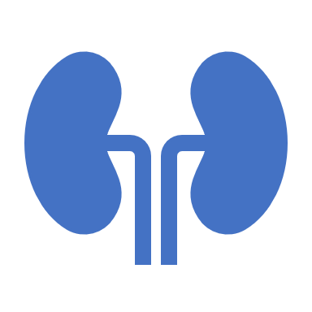
What are we aiming for?
<80y <140/90mmHg
>80y <150/90mmHg
CKD (with or without diabetes) ACR >70 <130/80mmHg

Slide 20
How can you prioritise those at highest risk?

Slide 21
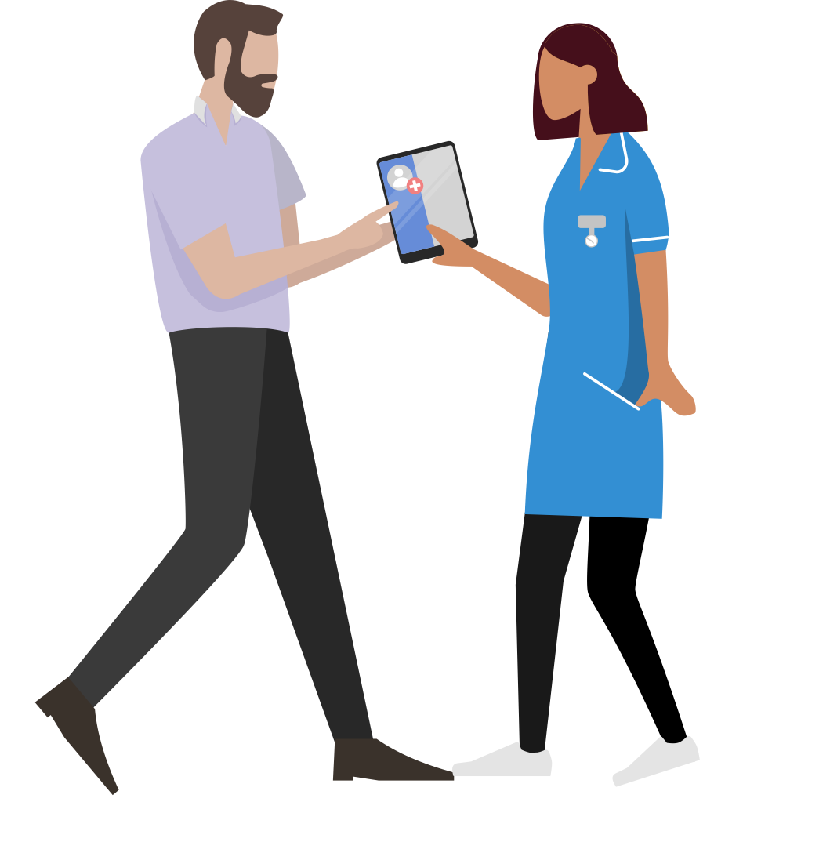
Workshop 1- 10 mins
Focusing on hypertension:
Consider any barriers you have faced to achieve treatment target.
What have you done so far as a PCN/practice towards achieving it?
Consider what can you do differently.

Slide 22
Let’s KISS
Keep it Simple and Smart
Search for hypertensive patients in practice without recent BP reading
Contact affected patients (e.g. AccuRx) to ask if home BP monitor (& record answer in clinical system)
If no home BP monitor, signpost to local community pharmacy/ alternative arrangement
Patients can ask community pharmacist for help feeding results back to practice (e.g. AccuRx)
Connect with local pharmacies offering the BP advanced service to agree referral patterns
Utilise care-coordinator/ pharmacy technician to monitor responses and triage BPs
Work with practice clinicians (practice pharmacist, nurse, GP) to optimise BP

Slide 23
Cholesterol

Slide 26
Notes:
539 patients

Slide 28
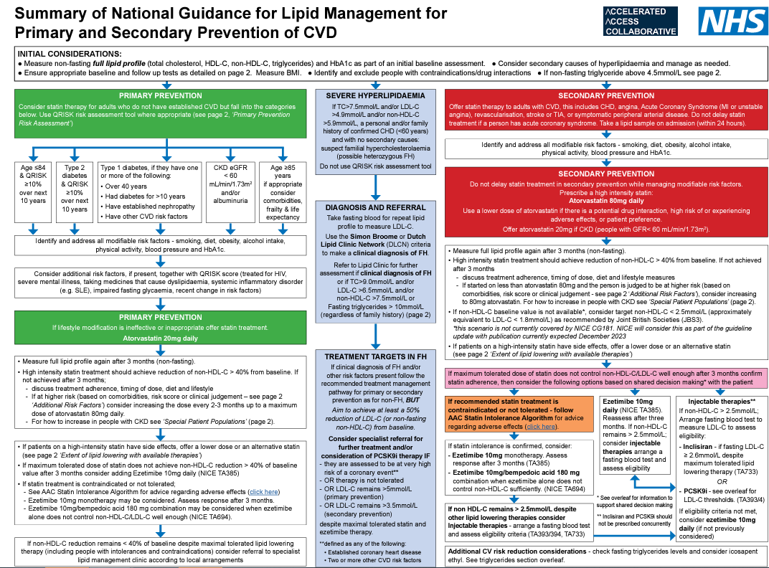
Changes to lipid management
Move away from TC and fire and forget
Focus on non-HDL/ LDL
Utilise combination therapy
Statin + ezetimibe
Ezetimbe + bempedoic acid
High intensity statins- atorvastatin, rosuvastatin (>40% reduction in LDL-C)
Offer statins more widely in primary prevention
Utilise statin intolerance pathway aiming to have patients on even a small dose of a statin
Injectable therapies for secondary prevention (and FH)
Icosapent ethyl for hypertriglyceridaemia

Slide 29
What are we aiming for?
Primary prevention
Non-HDL reduction of 40% from baseline
Secondary prevention
Non-HDL <2.5mmol/L
LDL <1.8mmol/L
Familial hypercholesterolaemia
LDL 50% reduction from baseline

Slide 30
Reminder on primary prevention
1st offer lifestyle advice
For primary prevention offer 20mg atorvastatin:
Age <84 and QRISK ≥10%
T2DM and QRISK ≥ 10%
T1DM >40/ DM <10 years/ established nephropathy/ other CVD risk factors
CKD eGFR <60 or ACR >30
If age >85 consider co-morbidities, frailty and life expectancy

Slide 31
QOF targets
 | Points | Thresholds
CHOL001. Percentage of patients on the QOF Coronary Heart Disease, Peripheral Arterial Disease, Stroke/TIA or Chronic Kidney Disease Register who are currently prescribed a statin, or where a statin is declined or clinically unsuitable, another lipid-lowering therapy | 14 | 70-95%
CHOL002. Percentage of patients on the QOF Coronary Heart Disease, Peripheral Arterial Disease, or Stroke/TIA Register, who have a recording of non-HDL cholesterol in the preceding 12 months that is lower than 2.5 mmol/L, or where non-HDL cholesterol is not recorded a recording of LDL cholesterol in the preceding 12 months that is lower than 1.8 mmol/L | 16 | 20-35%
DM022. The percentage of patients with diabetes aged 40 years and over, with no history of cardiovascular disease and without moderate or severe frailty, who are currently treated with a statin (excluding patients with type 2 diabetes and a CVD risk score of <10% recorded in the preceding 3 years) | 4 | 50-90%
DM023. The percentage of patients with diabetes and a history of cardiovascular disease (excluding haemorrhagic stroke) who are currently treated with a statin | 2 | 50-90%

Slide 32
How to prioritise those at highest risk
COHORT 1 CVD Not on a Statin
COHORT 2 CVD On Suboptimal Statin
COHORT 3 CVD On Suboptimal Statin Dose
COHORT 4 CVD Statin Optimised - Lipids > Target
Cohort 4a- eligible for injectables
Cohort 4b- not eligible for injectables

Slide 33
Example: process for reviewing lipids using pharmacy workforce
Pharmacy technician
Runs searches: UCLP or other searches available
Creates spreadsheet for data
Further prioritises/ filters patients by e.g. co-morbidity, younger age (can produce an auto report), out of date cholesterol level etc.
Undertakes a background review from the patient clinical record
Pharmacist
Reviews the background information collected by the PT
Categorises patients according to action i.e., appointment and SMR, refer GP, Bloods
Conducts Structured/ Comprehensive Medication Review (SMR)
Pharmacy technician
Supports process by (dependent on capacity):
Requests blood tests
Contacts appropriate patients for follow up
Makes SMR clinic appointments
Notes:
This is an example of how the pharmacy workforce can help review patients with high cholesterol

Slide 34
Dear Mouse-TestPatient,
Our medical practice regularly reviews patients’ records to ensure we continue to offer the best possible service tailored to the individual needs of each patient. We are looking at patients who used to be on statin medications to help lower cholesterol and will benefit from starting to use statin medications again.
Whilst cholesterol is essential for your body to work well, too much ‘bad cholesterol’ is unhealthy. High levels of ‘bad cholesterol’ in your blood can lead to fatty deposits building up in your arteries. This stops blood from flowing well and causes conditions such as heart attack and stroke.
Statins can help reduce the risk of strokes and heart attacks if taken regularly. They are one of the most researched medicines and there is very strong evidence that they help prevent the conditions described above.
We are aware from your record that you have taken, but not continued with, statins in the past. However, to help reduce your risk of developing heart disease, we advise that you now take a statin regularly and make changes to your lifestyle. Statins work best if taken long term.
A study in 2013 of over 100,000 people looked at those who reported side effects from statins. They were offered statin again and a year later, 90% of them were okay on the same or different statin. We would therefore like to offer you a statin again.
We want to make your return to statins as convenient as possible, and to maximise the benefits to your health. Therefore, a statin called Atorvastatin has been added to your repeat prescribing list and if you wish to start this medication, please request a prescription from reception in the usual way. When starting a statin, a routine blood test is advised after three months. Please arrange this with the practice in the usual way.
If you have any questions about your new prescription, please see the frequently asked questions document included with this letter or visit the West Yorkshire & Harrogate Healthy Hearts website www.westyorkshireandharrogatehealthyhearts.co.uk/cholesterol If you still have questions, please make an appointment with the practice.
Changes in lifestyle are important to help improve your health and reduce the risk of heart disease such as having a healthy diet, getting more exercise, losing weight, reducing the amount of alcohol and stopping smoking.
If you need an Easy Read version of this letter, please contact your GP practice or visit www.westyorkshireandharrogatehealthyhearts.co.uk/cholesterol

Slide 35
Workshop 2- 10 mins
Focusing on cholesterol:
Consider any barriers you have faced to achieving lipid targets
How can we increase the % of above whose LLT has been optimised?

Slide 36
AF

Slide 39
What are we aiming for?
95% of people with AF with CHADsVASc ≥2 on anticoagulation
DOAC 1st line

Slide 40
Recent changes
DOACs 1st line, warfarin only if can't have DOACs
Edoxaban 1st line for AF where:
Weight <120kg
CrCl <95mLs/min
Patient is suitable for any DOAC or any once daily DOAC
Note: edoxaban is not suitable for 12 months post percutaneous coronary intervention (PCI)
NICE very clear not to avoid anticoagulation because of age, falls or frailty
Ongoing legal battle over generic apixaban

Slide 41
What makes the difference?
Targeting unwarranted variation
Clinical leadership
Collaborative working
Public education
Designing care to be accessible to everyone

Slide 42
Workshop 3- 10 mins
How could a PCN CVD clinical lead support your PCN/ practice/ patients?
What sorts of roles would they do?

Slide 43
Examples of roles of the PCN CVD Lead
Understanding local data and identifying target areas of work that need to be done
Setting strategy for managing hypertension, lipids, AF (and sometimes HF and cardio-renal-metabolic disease) with relation to meeting QOF, QIS and other national targets
QI to improve patient experiences of care
Advancing and delivering new or improved CVD services
Developing local pathways within PCNs for things like management of CVD risk factors, post-event optimisation, early identification of those at risk
Educational strategy for other staff (not necessarily always delivery)
Shaking things up a bit by asking questions and getting people to identify variation and share best practice within the PCN
Attending educational or strategic events locally, regionally and nationally

Slide 45
Questions?

Slide 46
Resources- hypertension
Comms to use with patients- BPUK
Find a community pharmacy offering BP check service
DO NOT share this link with patients
BP@home SOP
Managing BP in special populations training
UCL Partners useful links for patients re. home BP readings
QRISK3 calculator
UCLPartners proactive care framework (you can get the searches from their website)

Slide 47
Resources- lipids
Manchester CVD prevention (lipid searches and educational series)
Heart age calculator
QRISK3 calculator
UCLP digital resources for patients on cholesterol
UCLPartners-Search-Tool Familial-Hypercholesterolaemia (you can get the searches from their website)

Slide 48
Resources- AF
Edoxaban resources and training
UCLP proactive care framework and digital resources for patients on AF (you can get the searches from their website)
DOAC dosing tool (password: DOAC)

